Slide 1
Redux
Lecturer: Ngo Huy Bien
Software Engineering Department
Faculty of Information Technology
VNUHCM - University of Science
Ho Chi Minh City, Vietnam
nhbien@fit.hcmus.edu.vn

Slide 2

Objectives

Slide 3

Contents

Slide 4

References
Kirupa Chinnathambi (2018). Learning React: A Hands-On Guide to Building Web Applications Using React and Redux. Addison-Wesley Professional.

Slide 5
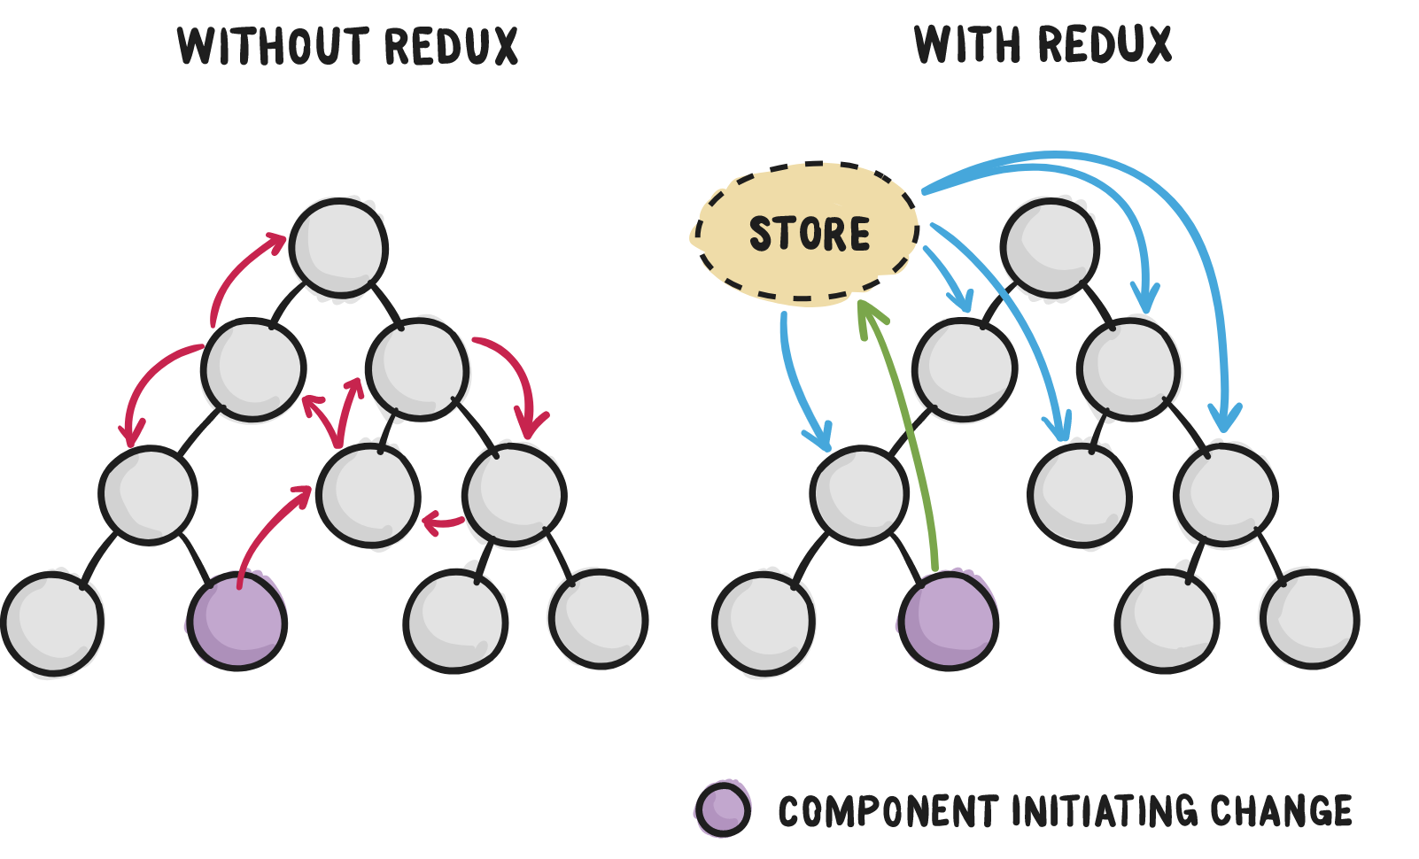
Multiple Components
When we write complex react app it become complex to manage state object when react app grows to multiple components.

Slide 6
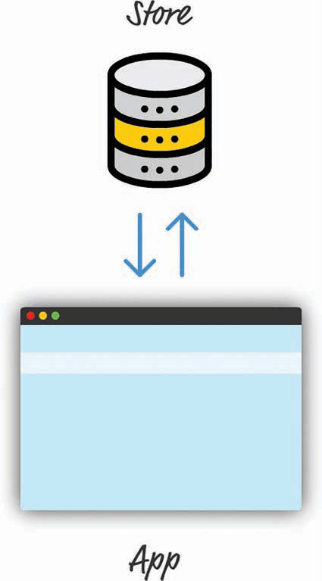
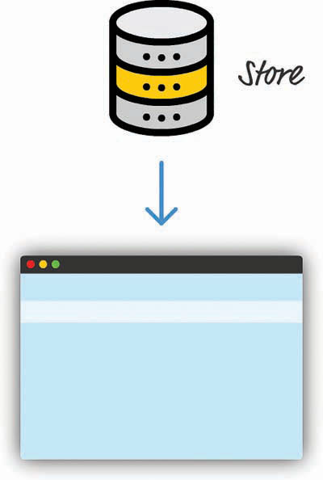
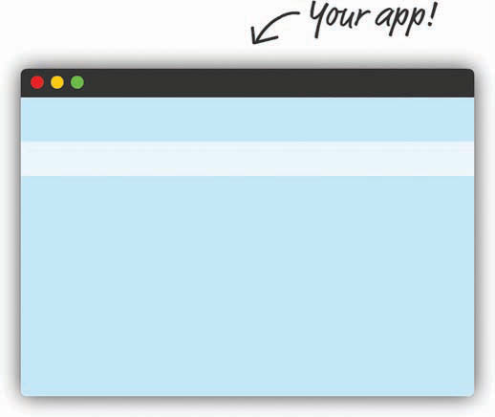
Application State Management
In the Redux world, we store all our application state in a single location that we'll just call the Store:

Slide 7
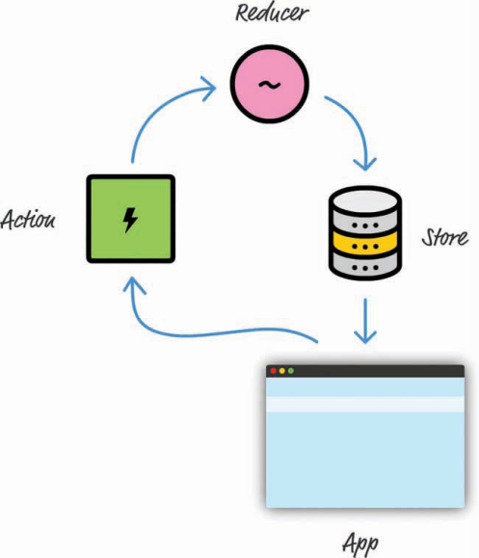
Redux
Your entire application's state is stored in a single location.
Your state should be read-only and can be modified only through actions.
You specify what the final state should be. To keep things simple, your state is never modified or mutated. You use a reducer to specify what the final result of your state should be.

Slide 8
Action (Command) Objects
<script type="text/javascript">
function addColor(value) {
// Return the action object
return {
type: "ADD",
color: value
};
}
function removeColor(value) {
// Return the action object
return {
type: "REMOVE",
color: value
};
}
...

Slide 9
Reducer Object
...
/* Given the same arguments, it should calculate the next state and return it.
No surprises. No side effects. No API calls. No mutations. Just a calculation. */
function favoriteColors(state, action) {
if (state === undefined) {
state = [];
}
if (action.type === "ADD") {
return state.concat(action.color);
} else if (action.type === "REMOVE") {
return state.filter(function (item) {
return item !== action.color;
});
} else {
return state;
}
}
...

Slide 10
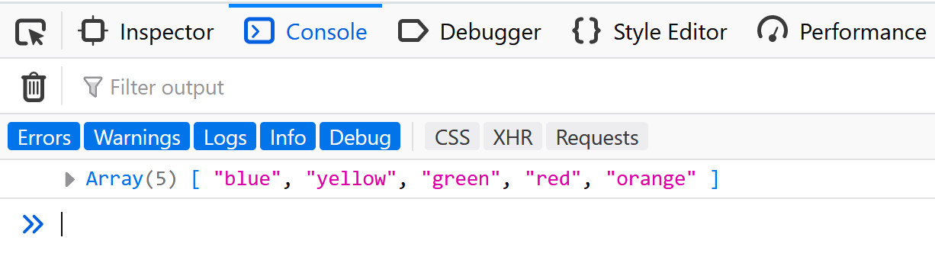
Reducer Object
...
var store = Redux.createStore(favoriteColors);
store.dispatch(addColor("blue"));
store.dispatch(addColor("yellow"));
store.dispatch(addColor("green"));
store.dispatch(addColor("red"));
store.dispatch(addColor("gray"));
store.dispatch(addColor("orange"));
store.dispatch(removeColor("gray"));
console.log(store.getState());
...

Slide 11
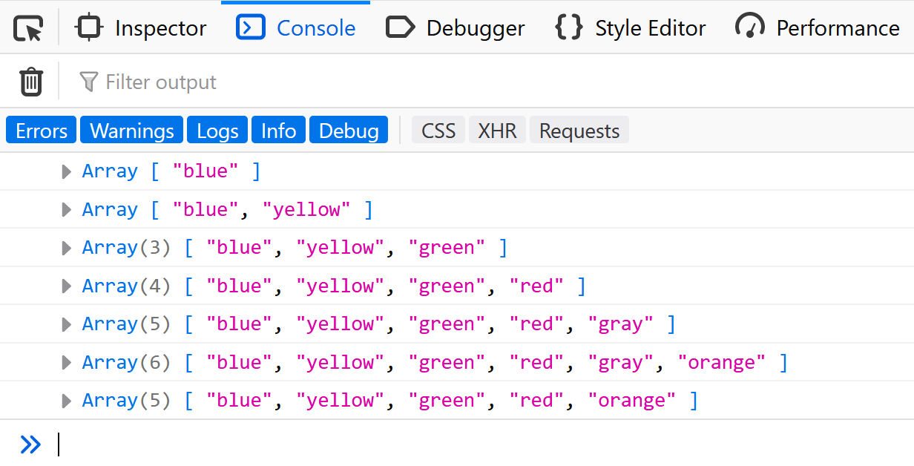
State Changes Notification
...
var store = Redux.createStore(favoriteColors);
store.subscribe(render);
store.dispatch(addColor("blue"));
store.dispatch(addColor("yellow"));
store.dispatch(addColor("green"));
store.dispatch(addColor("red"));
store.dispatch(addColor("gray"));
store.dispatch(addColor("orange"));
store.dispatch(removeColor("gray"));
function render() {
console.log(store.getState());
}
...

Slide 12
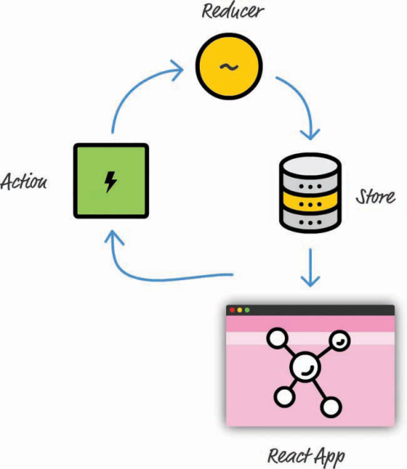
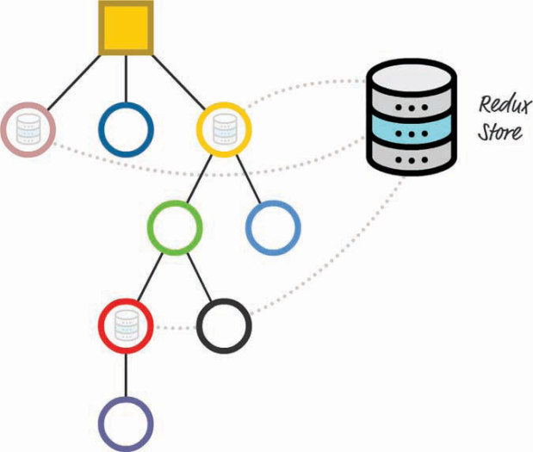
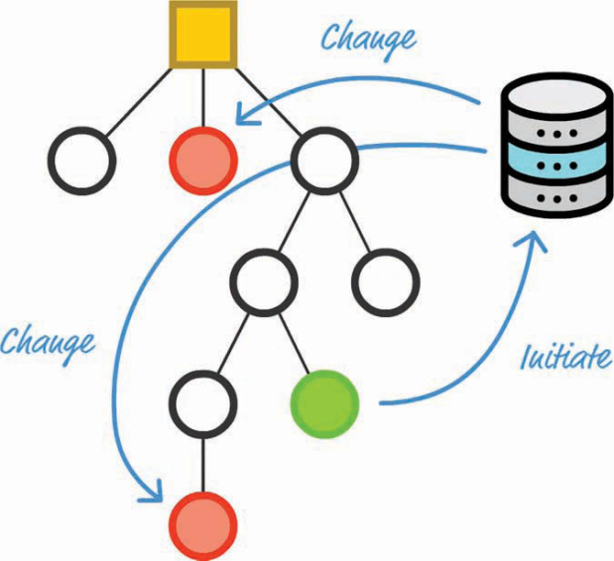
React State Management
The components that initiate a state change and the ones that need to react to it are often not in the same parent/child/descendant arrangement (a.k.a. subtree).

Slide 13
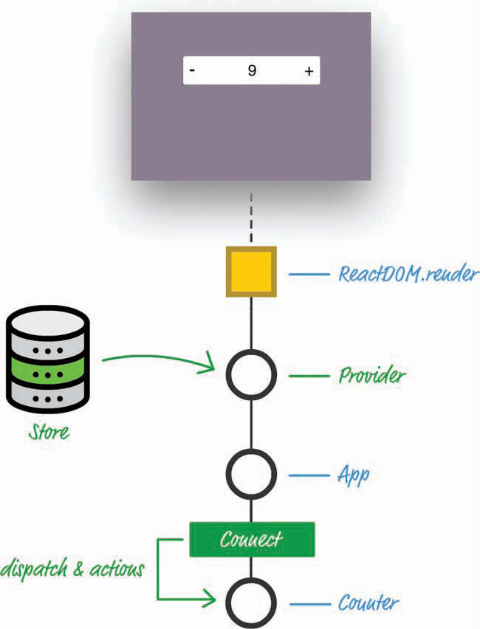
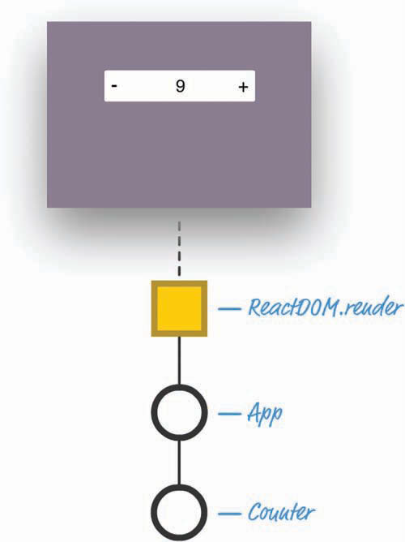
Use Case

Slide 14
Create redux-counter app
create-react-app redux-counter
cd redux-counter
npm install redux
npm install react-redux
npm start

Slide 15
Counter.js
// Counter.js
import React, { Component } from "react";
class Counter extends Component {
render() {
return (
<div className="container">
<button className="buttons"
onClick={this.props.decreaseCount}>-</button>
<span>{this.props.countValue}</span>
<button className="buttons"
onClick={this.props.increaseCount}>+</button>
</div>
);
}
}
export default Counter;

Slide 16
counterReducer.js
// counterReducer.js
function counterReducer(state, action) {
if (state === undefined) {
return { count: 0 };
}
var count = state.count;
switch (action.type) {
case "increaseCount":
return { count: count + 1 };
case "decreaseCount":
return { count: count - 1 };
default:
return state;
}
}
export default counterReducer;

Slide 17
App.js (Mapper)
import React from 'react';
import logo from './logo.svg';
import './App.css';
import { connect } from "react-redux";
import Counter from "./Counter";
// Map Redux state to component props
function mapStateToProps(state) {
return {
countValue: state.count
};
}
// Action
var increaseAction = { type: "increaseCount" };
var decreaseAction = { type: "decreaseCount" };
// Map Redux actions to component props
function mapDispatchToProps(dispatch) {
return {
increaseCount: function() {
return dispatch(increaseAction);
},
decreaseCount: function() {
return dispatch(decreaseAction);
}
};
}
// The HOC
var App = connect(
mapStateToProps,
mapDispatchToProps
)(Counter);
export default App;
<Connect>
<Counter increaseCount={increaseCount}
decreaseCount={decreaseCount}
countValue={countValue}/>
</Connect>

Slide 18
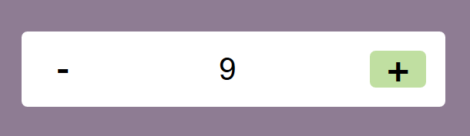
index.js
import React from 'react';
import ReactDOM from 'react-dom';
import './index.css';
import App from './App';
import * as serviceWorker from './serviceWorker';
import { createStore } from "redux";
import { Provider } from "react-redux";
import counterReducer from "./counterReducer";
// Store
var store = createStore(counterReducer);
ReactDOM.render(
<Provider store={store}>
<App />
</Provider>,
document.getElementById('root'));
// If you want your app to work offline and load faster, you can change
// unregister() to register() below. Note this comes with some pitfalls.
// Learn more about service workers: https://bit.ly/CRA-PWA
serviceWorker.unregister();

Slide 19

Thank You & See You Again

